Slide 1
Loops
BACS2023 Object-Oriented Programming
Appendix A4

Slide 2
Learning Objectives
At the end of this chapter, you should be able to
Use while, do-while, and for loop statements to control the repetition of statements.
Trace the flow of control in loop statements.
Use Boolean expressions to control loop statements.
Explain the similarities and differences between three types of loops.
Write nested loops to solve a given problem.
Implement program control with break and continue .

Slide 3
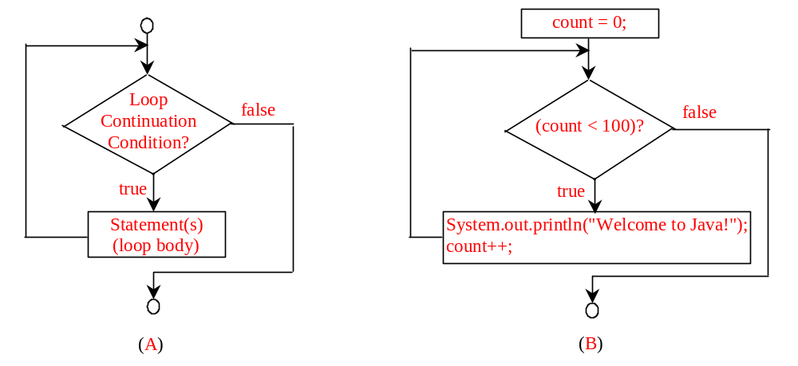
while Loop Flow Chart
int count = 0;
while (count < 100) {
System.out.println("Welcome to Java!");
count++;
}
while (loop-continuation-condition) {
// loop-body;
Statement(s);
}

Slide 4
Trace while Loop
animation
Initialize count
int count = 0;
while (count < 2) {
System.out.println("Welcome to Java!");
count++;
}

Slide 5
Trace while Loop, cont.
animation
(count < 2) is true
int count = 0;
while (count < 2) {
System.out.println("Welcome to Java!");
count++;
}

Slide 6
Trace while Loop, cont.
animation
Print Welcome to Java
int count = 0;
while (count < 2) {
System.out.println("Welcome to Java!");
count++;
}

Slide 7
Trace while Loop, cont.
animation
Increase count by 1
count is 1 now
int count = 0;
while (count < 2) {
System.out.println("Welcome to Java!");
count++;
}

Slide 8
Trace while Loop, cont.
animation
(count < 2) is still true since count is 1
int count = 0;
while (count < 2) {
System.out.println("Welcome to Java!");
count++;
}

Slide 9
Trace while Loop, cont.
animation
Print Welcome to Java
int count = 0;
while (count < 2) {
System.out.println("Welcome to Java!");
count++;
}

Slide 10
Trace while Loop, cont.
animation
Increase count by 1
count is 2 now
int count = 0;
while (count < 2) {
System.out.println("Welcome to Java!");
count++;
}

Slide 11
Trace while Loop, cont.
animation
(count < 2) is false since count is 2 now
int count = 0;
while (count < 2) {
System.out.println("Welcome to Java!");
count++;
}

Slide 12
Trace while Loop
animation
The loop exits. Execute the next statement after the loop.
int count = 0;
while (count < 2) {
System.out.println("Welcome to Java!");
count++;
}

Slide 13

Problem: Guessing Numbers
Write a program that randomly generates an integer between 0 and 100, inclusive. The program prompts the user to enter a number continuously until the number matches the randomly generated number. For each user input, the program tells the user whether the input is too low or too high, so the user can choose the next input intelligently. Here is a sample run:
GuessNumberOneTime
GuessNumber

Slide 14
Problem: An Advanced Math Learning Tool
The Math subtraction learning tool program generates just one question for each run. You can use a loop to generate questions repeatedly. This example gives a program that generates five questions and reports the number of the correct answers after a student answers all five questions.
SubtractionQuizLoop

Slide 15
Ending a Loop with a Sentinel Value
Often the number of times a loop is executed is not predetermined. You may use an input value to signify the end of the loop. Such a value is known as a sentinel value.
Write a program that reads and calculates the sum of an unspecified number of integers. The input 0 signifies the end of the input.
SentinelValue

Slide 16
Caution
Don’t use floating-point values for equality checking in a loop control. Since floating-point values are approximations, using them could result in imprecise counter values and inaccurate results. This example uses int value for data. If a floating-point type value is used for data, (data != 0) may be true even though data is 0.
// data should be zero
double data = Math.pow(Math.sqrt(2), 2) - 2;
if (data == 0)
System.out.println("data is zero");
else
System.out.println("data is not zero");

Slide 17
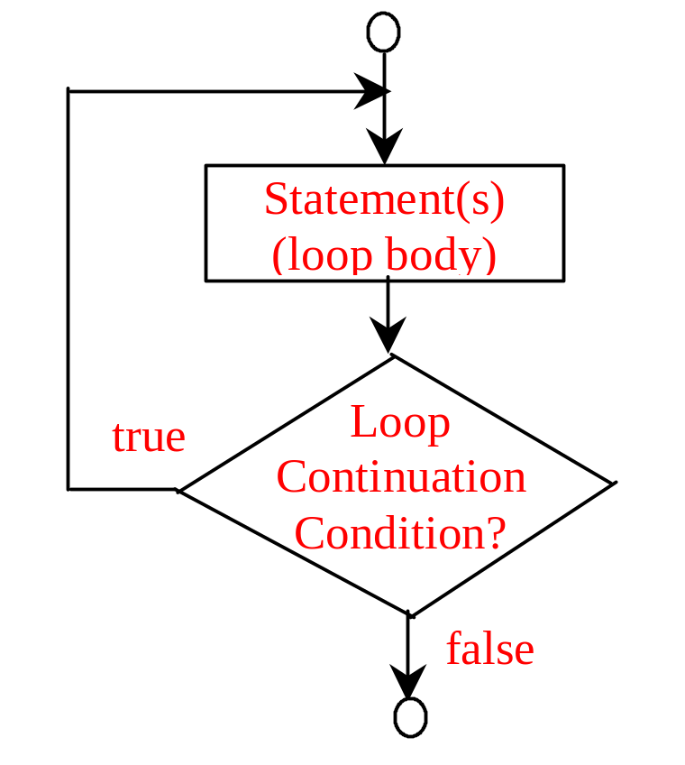
do-while Loop
do {
// Loop body;
Statement(s);
} while (loop-continuation-condition);

Slide 18
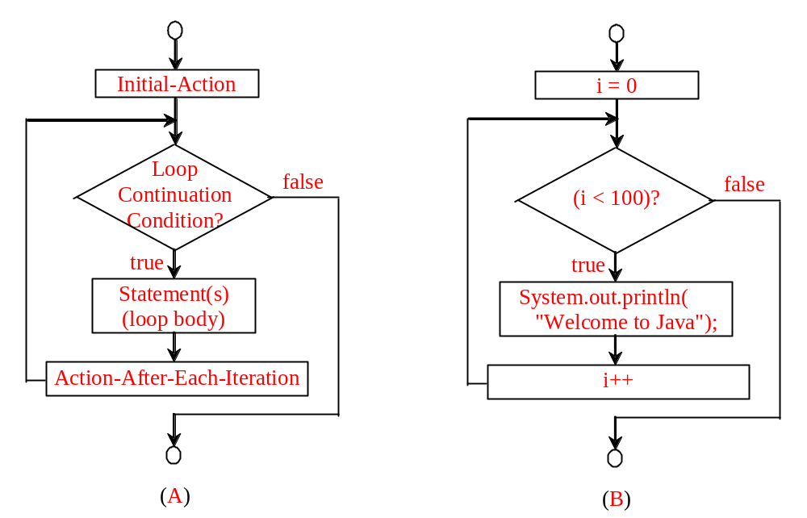
for Loops
for (initial-action; loop-continuation-condition; action-after-each-iteration) {
// loop body;
Statement(s);
}
int i;
for (i = 0; i < 100; i++) {
System.out.println(
"Welcome to Java!");
}

Slide 19
Trace for Loop
animation
Declare i
int i;
for (i = 0; i < 2; i++) {
System.out.println(
"Welcome to Java!");
}

Slide 20
Trace for Loop, cont.
animation
Execute initializer
i is now 0
int i;
for (i = 0; i < 2; i++) {
System.out.println(
"Welcome to Java!");
}

Slide 21
Trace for Loop, cont.
animation
(i < 2) is true
since i is 0
int i;
for (i = 0; i < 2; i++) {
System.out.println( "Welcome to Java!");
}

Slide 22
Trace for Loop, cont.
animation
Print Welcome to Java
int i;
for (i = 0; i < 2; i++) {
System.out.println("Welcome to Java!");
}

Slide 23
Trace for Loop, cont.
animation
Execute adjustment statement
i now is 1
int i;
for (i = 0; i < 2; i++) {
System.out.println("Welcome to Java!");
}

Slide 24
Trace for Loop, cont.
animation
(i < 2) is still true
since i is 1
int i;
for (i = 0; i < 2; i++) {
System.out.println("Welcome to Java!");
}

Slide 25
Trace for Loop, cont.
animation
Print Welcome to Java
int i;
for (i = 0; i < 2; i++) {
System.out.println("Welcome to Java!");
}

Slide 26
Trace for Loop, cont.
animation
Execute adjustment statement
i now is 2
int i;
for (i = 0; i < 2; i++) {
System.out.println("Welcome to Java!");
}

Slide 27
Trace for Loop, cont.
animation
(i < 2) is false
since i is 2
int i;
for (i = 0; i < 2; i++) {
System.out.println("Welcome to Java!");
}

Slide 28
Trace for Loop, cont.
animation
Exit the loop. Execute the next statement after the loop
int i;
for (i = 0; i < 2; i++) {
System.out.println("Welcome to Java!");
}

Slide 29
Note
The initial-action in a for loop can be a list of zero or more comma-separated expressions. The action-after-each-iteration in a for loop can be a list of zero or more comma-separated statements. Therefore, the following two for loops are correct. They are rarely used in practice, however.
  for (int i = 1; i < 100; System.out.println(i++));
  for (int i = 0, j = 0; (i + j < 10); i++, j++) {
  // Do something
  }

Slide 30

Note
If the loop-continuation-condition in a for loop is omitted, it is implicitly true. Thus the statement given below in (a), which is an infinite loop, is correct. Nevertheless, it is better to use the equivalent loop in (b) to avoid confusion:

Slide 31
Caution
Adding a semicolon at the end of the for clause before the loop body is a common mistake, as shown below:
Logic Error
for (int i=0; i<10; i++);
{
System.out.println("i is " + i);
}

Slide 32
Caution, cont.
Similarly, the following loop is also wrong:
int i=0;
while (i < 10);
{
System.out.println("i is " + i);
i++;
}
In the case of the do loop, the following semicolon is needed to end the loop.
int i=0;
do {
System.out.println("i is " + i);
i++;
} while (i<10);
Logic Error
Correct

Slide 33


Which Loop to Use?
The three forms of loop statements, while, do-while, and for, are expressively equivalent; that is, you can write a loop in any of these three forms. For example, a while loop in (a) in the following figure can always be converted into the following for loop in (b):
A for loop in (a) in the following figure can generally be converted into the following while loop in (b) except in certain special cases (see Review Question 3.19 for one of them):

Slide 34
Recommendations
Use the one that is most intuitive and comfortable for you. In general, a for loop may be used if the number of repetitions is known, as, for example, when you need to print a message 100 times. A while loop may be used if the number of repetitions is not known, as in the case of reading the numbers until the input is 0. A do-while loop can be used to replace a while loop if the loop body has to be executed before testing the continuation condition.

Slide 35
Nested Loops
Problem: Write a program that uses nested for loops to print a multiplication table.
MultiplicationTable

Slide 36
Using break and continue
Examples for using the break and continue keywords:
TestBreak.java
TestBreak
TestContinue.java
TestContinue

Slide 37
Guessing Number Problem Revisited
Listing 4.2 gives a program for guessing a number. You can rewrite it using a break statement, as shown in Listing 4.13.
GuessNumberUsingBreak

Slide 38
Debugging Loops in IDE Tools
Companion Website
Supplements II.C, II.E, and II.G.

Slide 39
Review of Learning Outcomes
You should now be able to
Use while, do-while, and for loop statements to control the repetition of statements.
Trace the flow of control in loop statements.
Use Boolean expressions to control loop statements.
Explain the similarities and differences between three types of loops.
Write nested loops to solve a given problem.
Implement program control with break and continue .

Slide 40
To Do
Review the slides and source code for this chapter.
Read up the relevant portions of the recommended text (see next slide).

Slide 41
Reference
Main text:
Chapter 4, pp. 131 - 155
Extracted from slides by Liang, Introduction to Java Programming, 7th Edition © 2009, Prentice Hall

